Slide 1
Artificial Intelligence (AI)
Celine Chehab

Slide 2
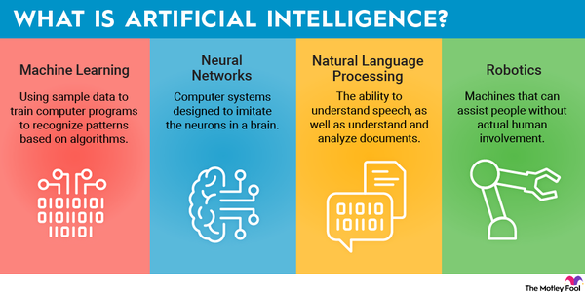
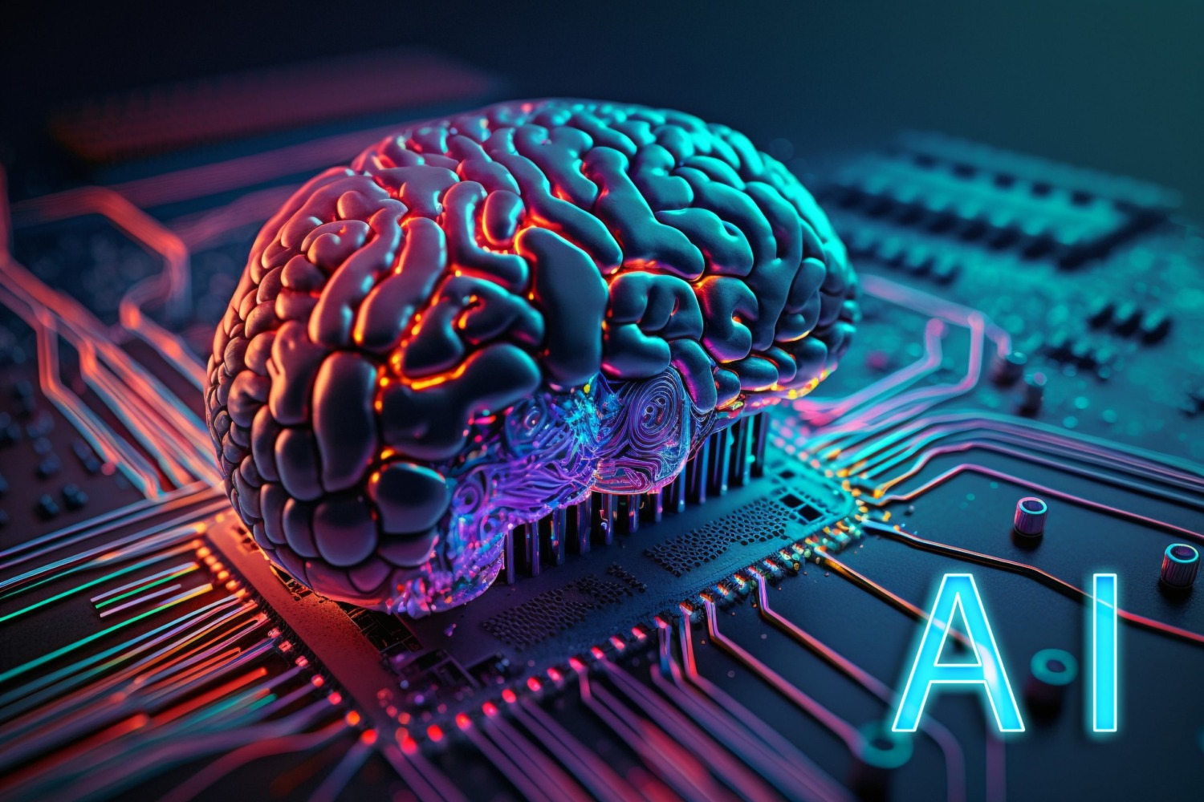
What is
Artificial Intelligence
AI
Definition
AI refers to systems that perform tasks usually requiring human intelligence like "reasoning, decision-making, and creativity" (NASA).

Slide 3
History of AI
In 1950, British mathematician Alan Turing asked if machines could think and introduced the Turing Test
Before the term artificial intelligence existed, people referred to the idea as cybernetics or automata theory.
AI
History
Mathematician James Slagle, blind since childhood, developed SAINT, one of the first “expert systems” that could solve symbolic calculus problems.
1990s–2000s, shifting toward solving specific tasks using more focused, efficient approaches.
Throughout the late 1950s and 1960s, researchers developed AI programs to solve problems, play games like chess, and simulate expert-level decision-making.

Slide 4
Types of Artificial Intelligence
Artificial Narrow Intelligence (ANI)
Reactive Machine AI
Limited Memory AI
Examples:
Example
Examples
AI
3 Types Of AI
Weak AI, is the only kind of AI we currently have — it's built to handle one specific task really well but can't go beyond that job.
These AIs don’t have memory; they only react to the present situation using real-time data.
This type can look at recent data and outcomes to improve future decisions. It remembers for a short period and gets better as it's trained with more data.
Includes Siri, Alexa, IBM Watson®, and ChatGPT, all of which focus on narrow functions like voice commands or chatting.
Netflix’s recommendation engine, which suggests shows based on your current watching habits.
Chatgbt, Virtual assistants, (Siri, Alexa) and self driving cars.

Slide 5
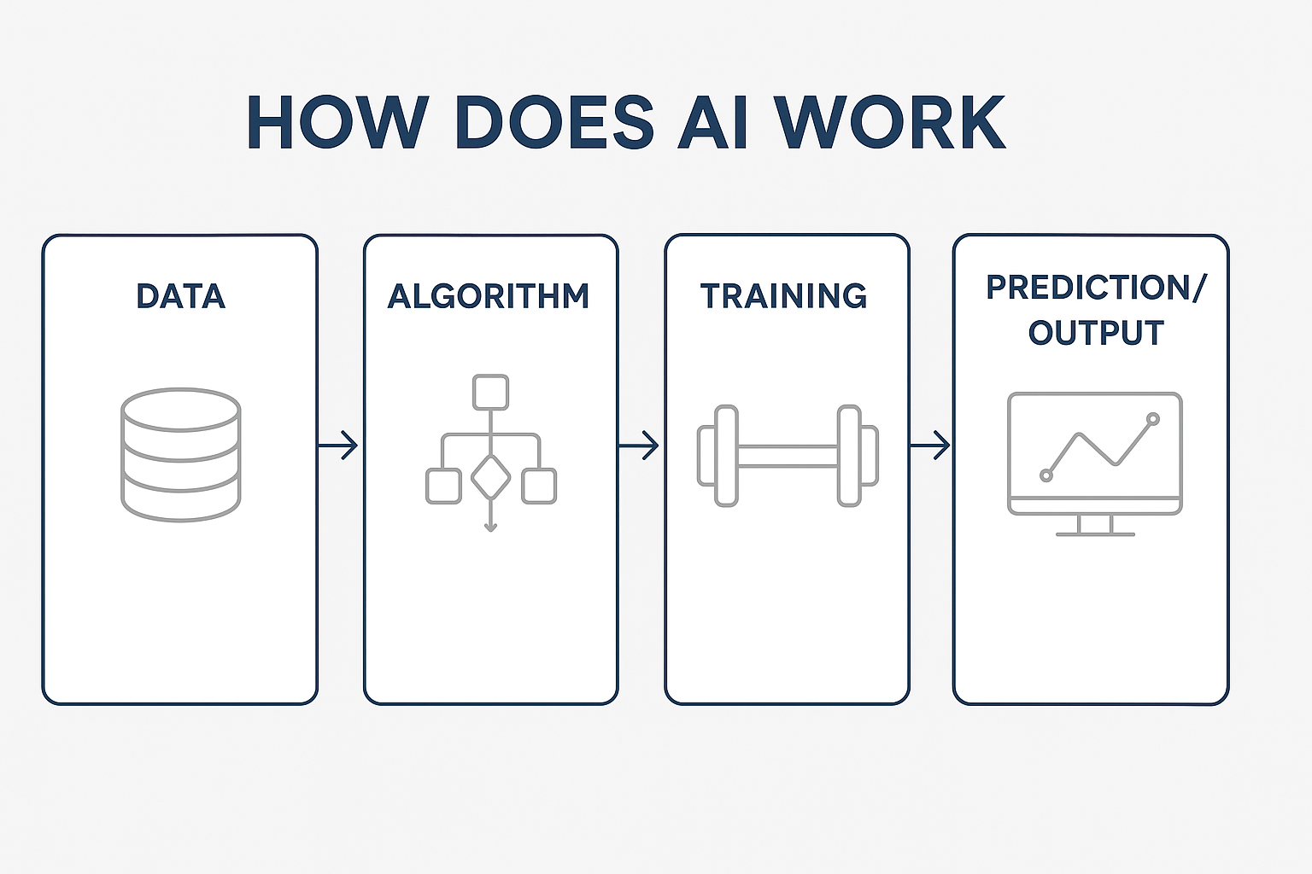
Game Playing AI focuses on developing algorithms capable of playing strategy games, such as chess, at a high level. ​
Natural Language Processing (NLP) enables machines to comprehend, interpret, and generate human language, facilitating applications like chatbots and voice recognition systems. ​
How AI Works
AI
How AI Works
Artificial Intelligence (AI) operates by emulating human intelligence through algorithms, data, and computational power, aiming to perform tasks like learning, reasoning, problem-solving, perception, and language understanding
Machine Learning (ML), a subset of AI, involves creating algorithms that allow computer systems to learn patterns and make decisions from data without explicit programming. ​
Neural Networks, inspired by the human brain's structure, consist of interconnected nodes that process data, enabling tasks such as image recognition and natural language processing. ​

Slide 6
Why do we use AI?
AI
WHY AI?
Smart Homes and Infrastructure: AI contributes to energy efficiency and improved living conditions through smart thermostats and city infrastructure that adapt to user habits and environmental conditions. ​
Automotive Safety: AI enhances vehicle safety features, such as collision detection and autonomous driving capabilities, leading to safer transportation systems. ​
Cybersecurity: AI aids in detecting and responding to cyber threats by analyzing patterns and anomalies in data, bolstering defense mechanisms against attacks. ​
Healthcare Advancements: AI assists in medical diagnostics and patient monitoring, contributing to more accurate diagnoses and personalized treatment plans. ​
Agricultural Efficiency: AI supports precision farming by analyzing data on weather, soil conditions, and crop health, leading to optimized resource use and increased yields.
Notes:
Why do we use

Slide 7

Outcome: This AI-recommended therapy led to significant improvement in Coates's health, enabling him to undergo a life-saving stem cell transplant four months later.
Significance: This case exemplifies how AI can uncover new applications for existing medications, offering hope to patients with rare diseases lacking established treatments.
AI's Role in Life-Saving Drug Repurposing
AI
AI in medicine
Patient Background: Joseph Coates, 37, was diagnosed with POEMS syndrome, a rare blood disorder affecting multiple organs. His condition deteriorated to the point where conventional treatments were deemed ineffective, and doctors had exhausted available options.
AI Intervention: Refusing to give up, Coates's girlfriend reached out to Dr. David Fajgenbaum, who utilized artificial intelligence to analyze existing medical data. The AI system identified a novel combination of chemotherapy, immunotherapy, and steroids as a potential treatment.​

Slide 8
Future Of AI
AI
Future Of AI
Jobs: AI will replace some jobs but also create new ones retraining will be key.
Business: It’ll boost productivity by automating tasks and improving decision-making.
Healthcare: AI will help diagnose diseases and personalize treatments.
Education: Learning will become more personalized based on student needs.
Finance: AI will assist in smart trading and managing investment funds.
Military/Cybersecurity: Used for defense systems and detecting cyber threats.
Transportation: Helps manage traffic, predict issues, and monitor vehicles.
Advertising: Ads will be more personalized based on user behavior.
Communication: Improves access for people with disabilities and language barriers.
Ethics: AI raises concerns like bias, privacy, and fairness — guidelines are needed.

Slide 9
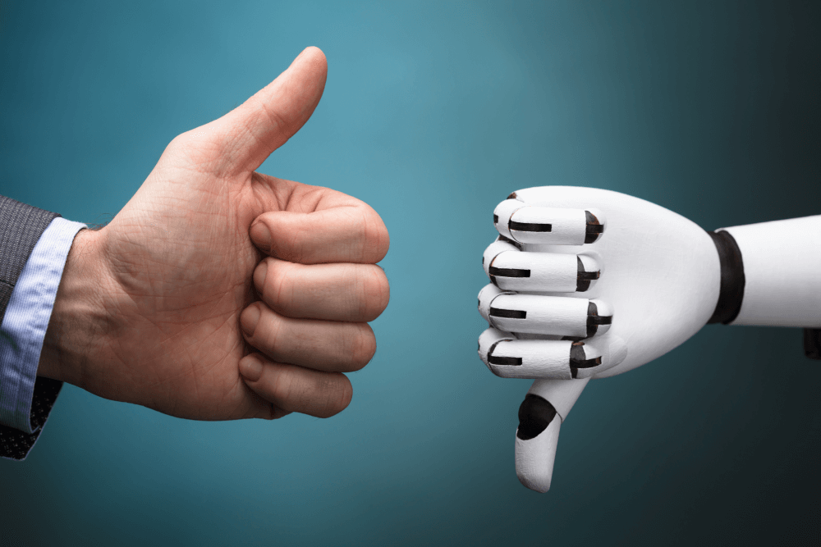
Negative impacts of AI
AI
Negative Impacts
Job Displacement: Automation driven by AI could replace human workers in various industries, leading to unemployment and economic challenges. ​
Safety Concerns: Errors or unintended behaviors in AI systems, particularly in critical areas like healthcare or autonomous driving, can result in physical harm or fatalities. ​
Discriminatory Outcomes: AI systems can inadvertently produce biased results, leading to unfair treatment of individuals or groups, especially in sectors like employment and law enforcement. ​
Erosion of Human Autonomy: Overreliance on AI decisions may diminish individual decision-making capabilities and reduce human control over important life aspects. ​

Slide 10
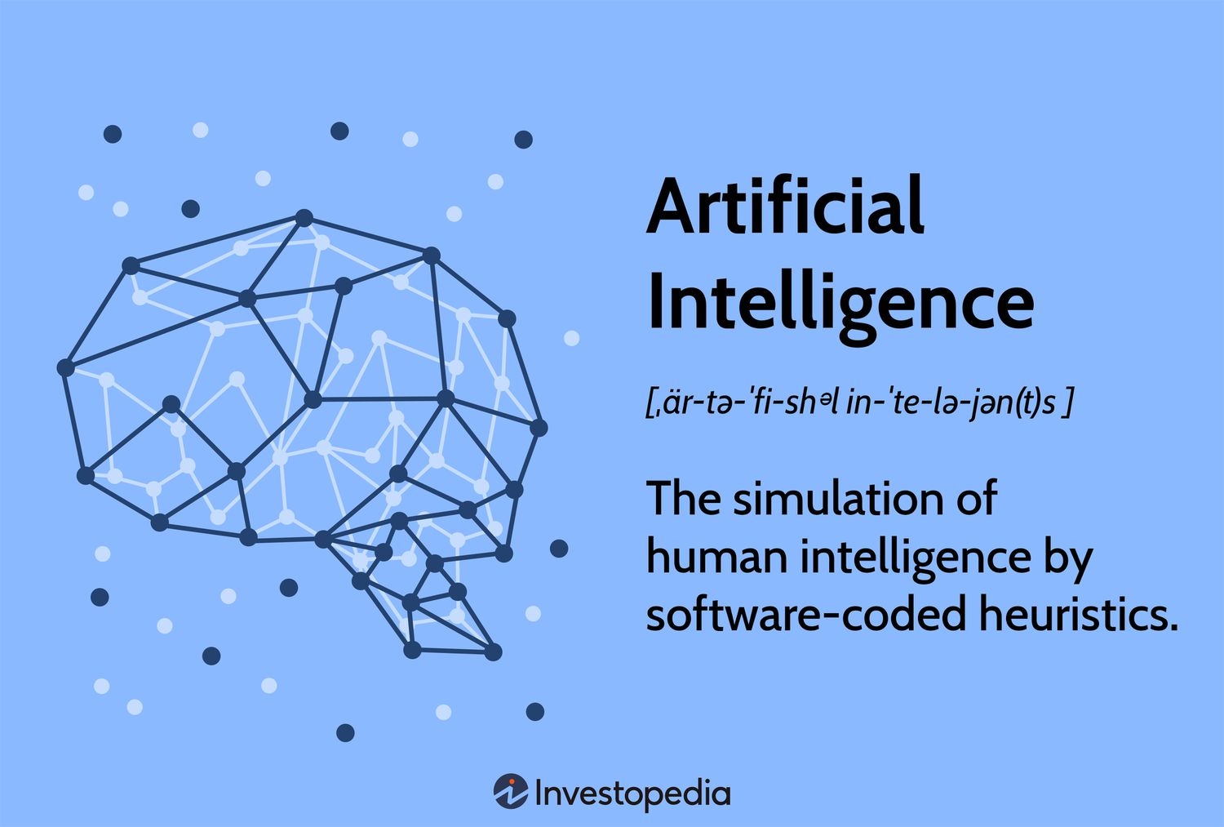
Thank you!

Slide 11
Citations
AI
Citations
NASA. What Is Artificial Intelligence? 6 Mar. 2024, www.nasa.gov/what-is-artificial-intelligence/. Accessed 9 Apr. 2025.
Whiting, Melanie. Doctors Left a Sick Man for Dead — but Then AI Saved His Life. BGR, 4 Apr. 2024, https://bgr.com/science/doctors-left-a-sick-man-for-dead-but-then-ai-saved-his-life/. Accessed 9 Apr. 2025.
Lawrence Livermore National Laboratory. The Birth of Artificial Intelligence (AI) Research. 9 Aug. 2021, https://st.llnl.gov/news/look-back/birth-artificial-intelligence-ai-research. Accessed 9 Apr. 2025.’
University of Illinois Chicago. AI (Artificial Intelligence): What Is the Definition of AI and How Does AI Work? 3 Oct. 2023, https://meng.uic.edu/news-stories/ai-artificial-intelligence-what-is-the-definition-of-ai-and-how-does-ai-work/. Accessed 9 Apr. 2025.

